Slide 1



Multi-Task Graph Neural Network for Truck Speed Prediction Under Extreme Weather Conditions
In The 30th International Conference on Advances in Geographic Information Systems (SIGSPATIAL ’22), November 1–4, 2022, Seattle, WA, USA. ACM SIGSPATIAL, Seattle, WA, USA.

Slide 2
2
Introduction:
Truck speed prediction plays a key role in truck transportation management.
truck traffic data is typically sparse and noisy, which makes the truck speed prediction an even more challenging task.
Most of the existing traffic prediction methods lack the ability to model the dynamic spatial-temporal correlations of truck traffic or ignore contributing contextual factors that impact traffic.
- Additionally, traffic congestions and poor driving conditions caused by extreme weather conditions can make sudden changes in the general pattern of the truck speed.

Slide 3
3
Goal:
How can Spatio-temporal and other contextual information be incorporated with historical truck trajectories to achieve the best truck speed prediction results?
How can improve truck speed prediction accuracy by taking advantage of other relevant truck traffic information (such as the truck flow)?
How to deal with under-represented truck traffic data under extreme weather conditions?

Slide 4
4
Work:
We proposes a novel Multi-Task Context Based Gated Recurrent Unit Graph Convolutional Network (MT-C2G) for the truck speed prediction under the extreme weather conditions.
this is the first study to apply the Multi-Task Learning (MTL) to describe the actual correlation between the truck speed and flow to predict the truck speed, along with using the oversampling technique on truck GPS data under the extreme weather conditions.
(MT-C2G) includes four major components:
Spatial dependence learning component(GCN).
Truck traffic feature temporal dependence modeling component(GRU).
The multi-task learning component (Attention mechanism).
Synthetic Minority Oversampling Technique (SMOTE)
Notes:
Synthetic Minority Oversampling Technique 合成少數過採樣技術

Slide 5
5
Definition 1 (Interchanged Road Network):
An interchanged road network is an unweighted graph denoted by G = (V, E) where 𝑉 = {𝑣₁,𝑣₂, . . . ,𝑣_{𝑅}} corresponds to the set of vertices in 𝐺,representing the road segments of the road network. 𝐸 = {𝑒₁,𝑒₂, . . . ,𝑒_{𝐼}} represents the set of edges contained in 𝐺.
Two vertices in graph 𝐺 are adjacent if and only if the corresponding road segments are connected in the road network.
The adjacency matrix of the interchange road network 𝐺 is denoted by 𝐴_{𝐺} ∈ 𝑍^{|𝑉|×|𝑉|} .
The value of each element 𝑎_{𝑖,𝑗} , where 𝑖, 𝑗 ∈ 𝑉 , is 1 if and only if there exists an edge 𝑒_{𝑘} ∈ 𝐸 between those two vertices, and 0 if otherwise.

Slide 6
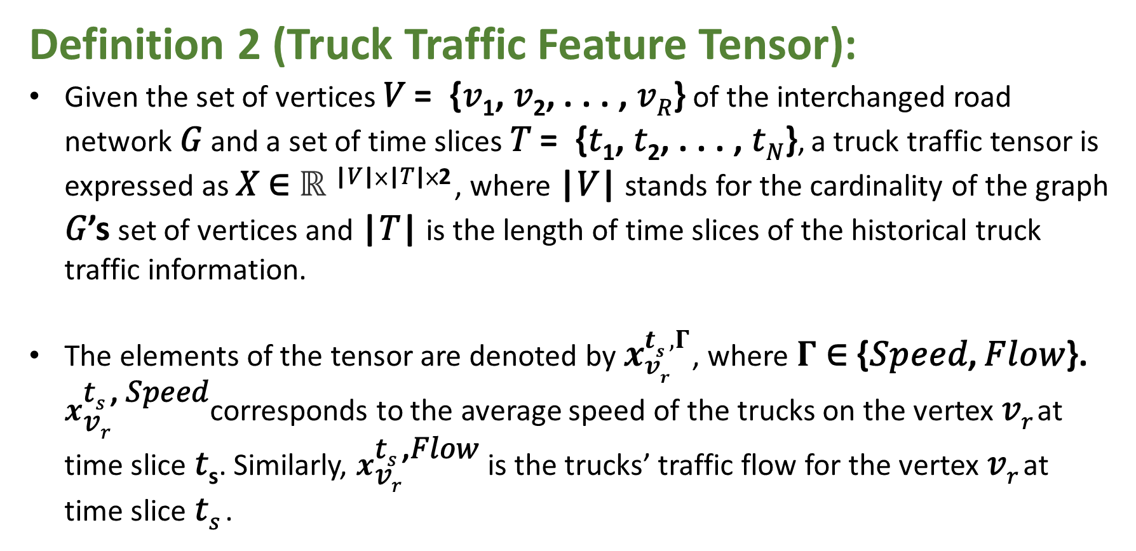
6
Definition 2 (Truck Traffic Feature Tensor):
Given the set of vertices 𝑉 = {𝑣₁, 𝑣₂, . . . , 𝑣_{𝑅}} of the interchanged road network 𝐺 and a set of time slices 𝑇 = {𝑡₁, 𝑡₂, . . . , 𝑡_{𝑁}}, a truck traffic tensor is expressed as 𝑋 ∈ ℝ ^{|𝑉|×|𝑇|×2} , where |𝑉| stands for the cardinality of the graph 𝐺’s set of vertices and |𝑇| is the length of time slices of the historical truck traffic information.
The elements of the tensor are denoted by $x_{vr}^{ts ,Γ}$, where $Γ$ ∈ {𝑆𝑝𝑒𝑒𝑑, 𝐹𝑙𝑜𝑤}. $x_{\text{v}\text{r}}^{\text{t}\text{s} \text{,} \text{Speed}}$corresponds to the average speed of the trucks on the vertex 𝑣_{𝑟} at time slice 𝑡_{s}. Similarly, $x_{\text{v}\text{r}}^{\text{t}\text{s} \text{,}\text{Flow}}$ is the trucks’ traffic flow for the vertex 𝑣_{𝑟} at time slice 𝑡_{𝑠} .

Slide 7
7
Definition 3 (Contextual Feature Tensor):
Given the set of vertices 𝑉 = { 𝑣₁, 𝑣₂, . . . , 𝑣_{𝑅} } of the interchanged road network 𝐺 and a set of time slices 𝑇 = { 𝑡₁, 𝑡₂, . . . , 𝑡_{𝑁} } a contextual feature tensor, denoted by 𝐶, is a tensor with dimension |𝑉| × |𝑇| × 𝑝, where 𝑝 stands for the number of contextual features.
Contextual features describe the contributing factors other than the historical truck traffic information that affect the truck traffic. The contextual features considered in this paper includes:
- Weather: Different weather conditions are classified and assigned an integer value to each class.
- Business day/Holiday: The value corresponding to this feature takes value 1 if the day is a business day, and 0 if it is a holiday.
- Day of the week: A discrete value is used to represent each day of the week.
- Time of the day: This feature shows different time of the day, such as in hours.

Slide 8
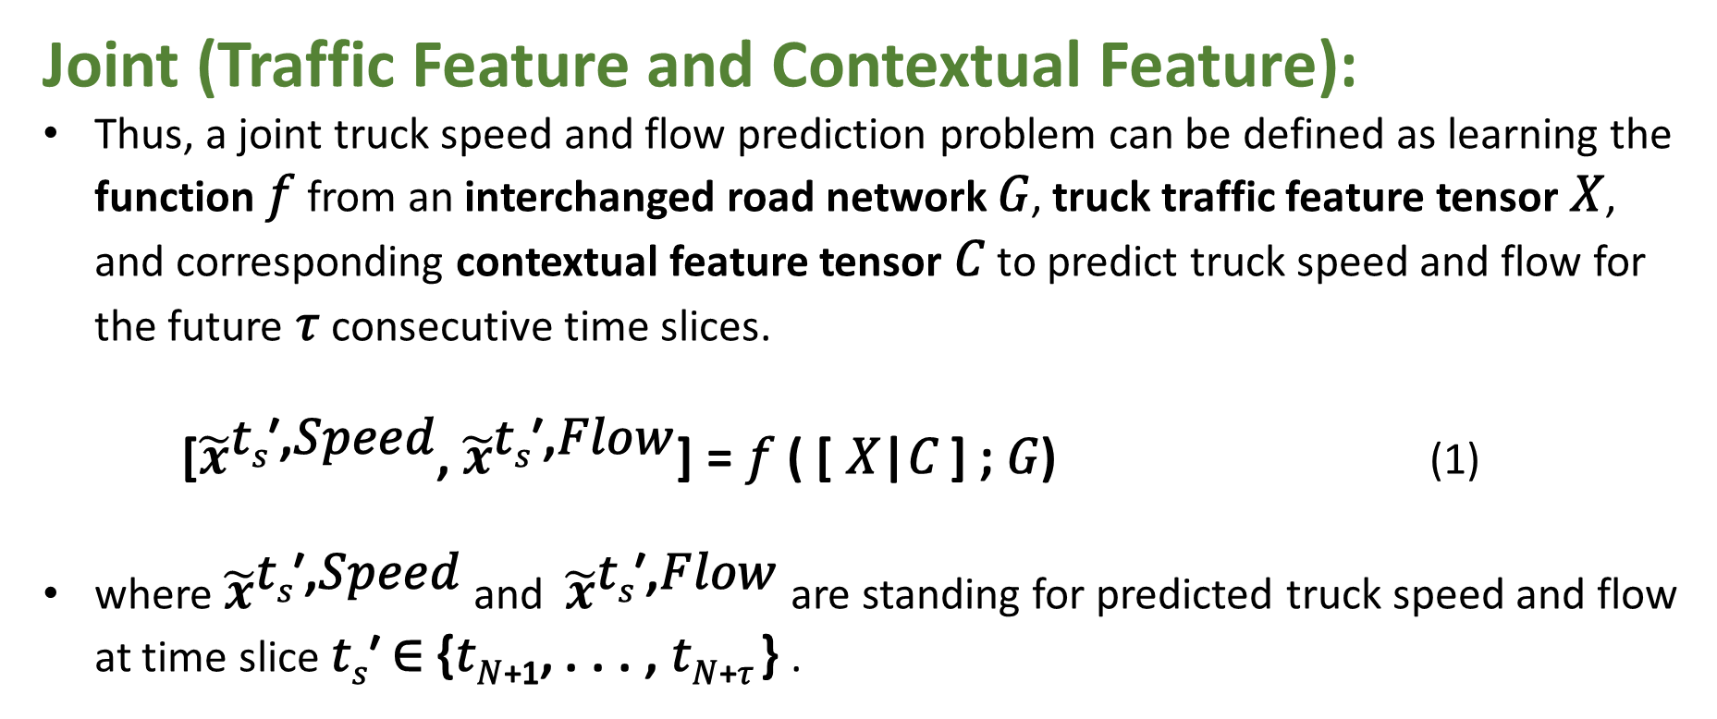
8
Joint (Traffic Feature and Contextual Feature):
Thus, a joint truck speed and flow prediction problem can be defined as learning the function 𝑓 from an interchanged road network 𝐺, truck traffic feature tensor 𝑋, and corresponding contextual feature tensor 𝐶 to predict truck speed and flow for the future 𝜏 consecutive time slices.
[${\tilde{x}}^{\text{t}\text{s}\text{′,}\text{Speed}}$, ${\tilde{x}}^{\text{t}\text{s}\text{′,}\text{Flow}}$] = 𝑓 ( [ 𝑋|𝐶 ] ; 𝐺) (1)
where ${\tilde{x}}^{\text{t}\text{s}\text{′,}\text{Speed}}$and ${\tilde{x}}^{\text{t}\text{s}\text{′,}\text{Flow}}$are standing for predicted truck speed and flow at time slice 𝑡_{𝑠}′ ∈ {𝑡_{𝑁+1}, . . . , 𝑡_{𝑁+𝜏} } .

Slide 9
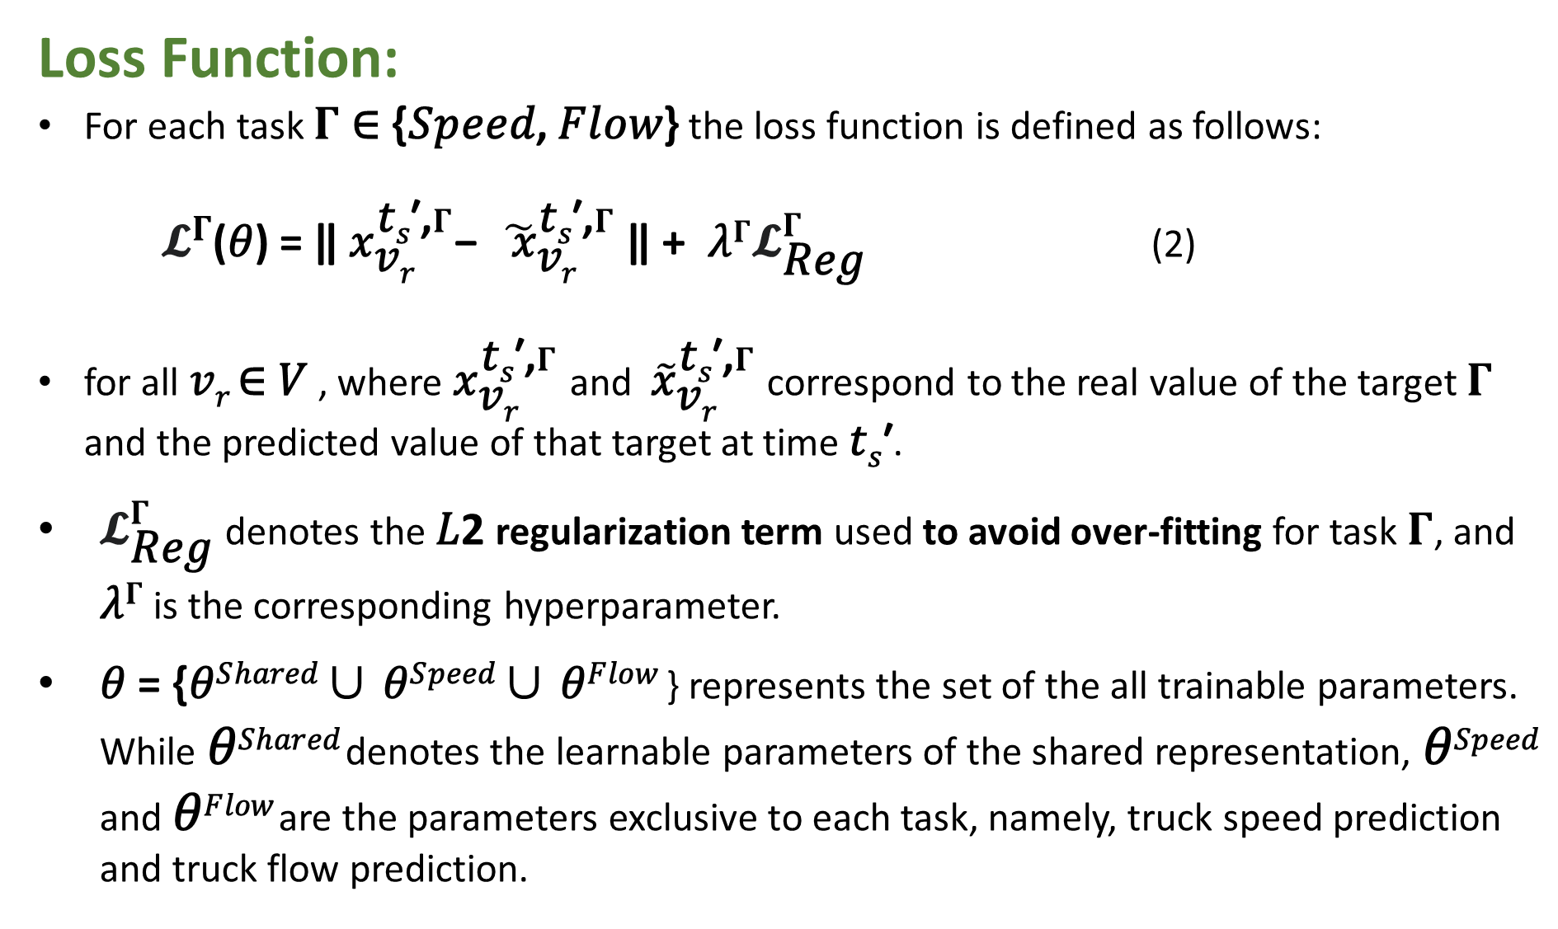
9
Loss Function:
For each task $Γ$ ∈ {𝑆𝑝𝑒𝑒𝑑, 𝐹𝑙𝑜𝑤} the loss function is defined as follows:
𝓛$Γ$(𝜃) = ǁ ${\text{x}}_{\text{v}\text{r}}^{\text{t}\text{s}\text{′,}Γ}$− ${\tilde{ \text{x}}}_{\text{v}\text{r}}^{\text{t}\text{s}\text{′,}Γ}$ ǁ + 𝜆$Γ{\text{𝓛}}_{\text{Reg}}^{Γ}$ (2)
for all 𝑣_{𝑟} ∈ 𝑉 , where ${\text{x}}_{\text{v}\text{r}}^{\text{t}\text{s}\text{′,}Γ}$ and ${\tilde{\text{x}}}_{\text{v}\text{r}}^{\text{t}\text{s}\text{′,}Γ}$correspond to the real value of the target $Γ$ and the predicted value of that target at time 𝑡_{𝑠}′.
${\text{𝓛}}_{\text{Reg}}^{Γ}$denotes the 𝐿2 regularization term used to avoid over-fitting for task $Γ$, and 𝜆$Γ$ is the corresponding hyperparameter.
𝜃 = {𝜃^{𝑆ℎ𝑎𝑟𝑒𝑑} ∪ 𝜃^{𝑆𝑝𝑒𝑒𝑑} ∪ 𝜃^{𝐹𝑙𝑜𝑤} } represents the set of the all trainable parameters. While 𝜃^{𝑆ℎ𝑎𝑟𝑒𝑑} denotes the learnable parameters of the shared representation, 𝜃^{𝑆𝑝𝑒𝑒𝑑} and 𝜃^{𝐹𝑙𝑜𝑤} are the parameters exclusive to each task, namely, truck speed prediction and truck flow prediction.
Notes:
https://dysonma.github.io/2021/01/27/%E6%A9%9F%E5%99%A8%E5%AD%B8%E7%BF%92-%E6%AD%A3%E8%A6%8F%E5%8C%96-Regularization/

Slide 10
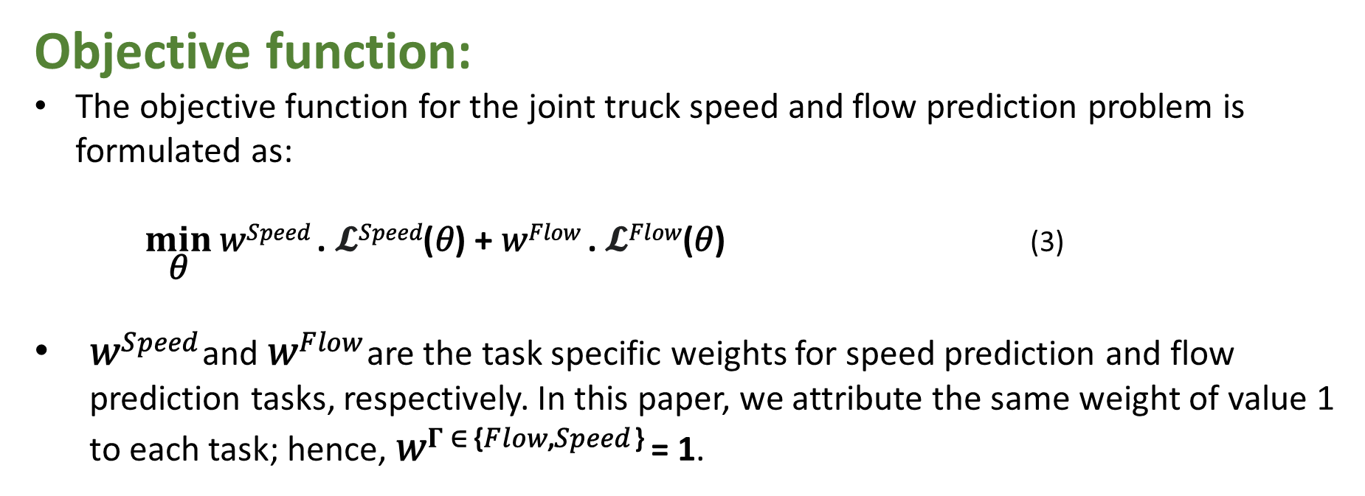
10
Objective function:
The objective function for the joint truck speed and flow prediction problem is formulated as:
$\min_{\text{θ}}{\text{w}\text{Speed} \text{.} \text{𝓛}\text{Speed}\text{(}\text{θ}\text{) + }\text{w}\text{Flow} \text{. }\text{𝓛}\text{Flow}\text{(}\text{θ}\text{)}}$ (3)
𝑤^{𝑆𝑝𝑒𝑒𝑑} and 𝑤^{𝐹𝑙𝑜𝑤} are the task specific weights for speed prediction and flow prediction tasks, respectively. In this paper, we attribute the same weight of value 1 to each task; hence, 𝑤$Γ$^{∈ {𝐹𝑙𝑜𝑤,𝑆𝑝𝑒𝑒𝑑 }} = 1.

Slide 11
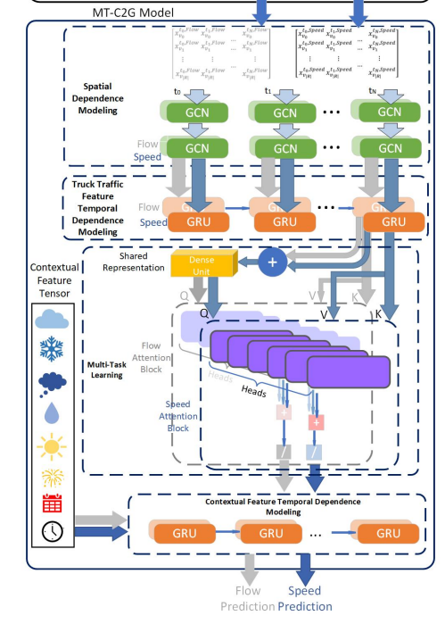
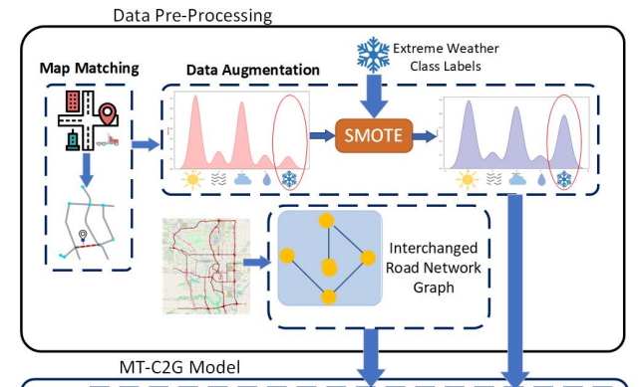
11
Architecture
To improve accuracy of the predictions, instead of using a STL approach, MT-C2G takes advantage of the commonalities between the truck speed and flow prediction tasks, through jointly optimizing a shared model.

Slide 12
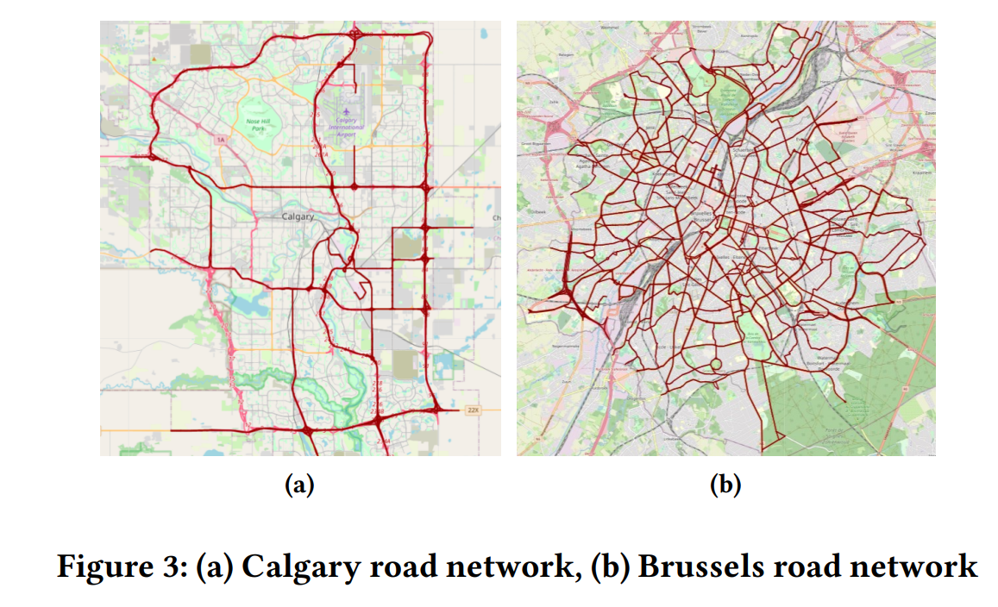
12
Data Preprocessing:
The road networks of Calgary and Brussels are retrieved from Open Street Map, as shown in Figure 3, and the weather data is collected from public weather APIs available for both cities.
The Calgary truck data is provided by American Transportation Research Institute (ATRI) for the year 2019. More than 11,000 trucks are included during the period and the total number of GPS records is nearly 22,000,000.

Slide 13
13
Data Preprocessing:
For each truck, the raw GPS dataset includes the truck ID, longitude, latitude, timestamp, current driving speed, and direction.
To convert the raw GPS signals into the truck traffic speed and flow on the road segments, a Hidden Markov Model (HMM) based algorithm for map matching is first used to match the GPS points to corresponding road segments.
For the data preprocessing, the Hidden Markov Model (HMM) map matching method is first applied on the truck GPS datasets.
After map matching, we are able to obtain GPS points information on each road segment for trucks over each time step for both datasets.
Then we re-sample and calculate the number of passing trucks on each road segment, as well as their average speed. The road segments without speed and flow data are removed.
Notes:
https://web.ntnu.edu.tw/~algo/HiddenMarkovModel.html#2 https://www.ismll.uni-hildesheim.de/lehre/semSpatial-10s/script/6.pdf

Slide 14
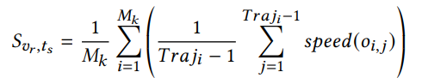
14
Data Preprocessing:
The average speed of trucks on the road segment 𝑣_{𝑟}, 𝑆_{𝑣𝑟,𝑡𝑠} , is calculated as follows:
(4)
where 𝑀_{𝑘} denotes the number of trajectories passing road segment 𝑣_{𝑟}, 𝑇𝑟𝑎𝑗_{𝑖} denotes the number of GPS points in the part of the trajectory 𝑖 passing through the road segment 𝑣_{𝑟}.
𝑜_{𝑖,𝑗} denotes the 𝑗-th original GPS point of the trajectory 𝑖, passing through the road segment 𝑣_{𝑟}.
𝑠𝑝𝑒𝑒𝑑 (𝑜_{𝑖,𝑗}) represents the speed information of the matching point 𝑜_{𝑖,𝑗 .}The calculation results are then used to generate the truck traffic tensor.
Notes:
https://zh.wikipedia.org/zh-tw/%E9%9A%90%E9%A9%AC%E5%B0%94%E5%8F%AF%E5%A4%AB%E6%A8%A1%E5%9E%8B

Slide 15
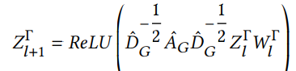
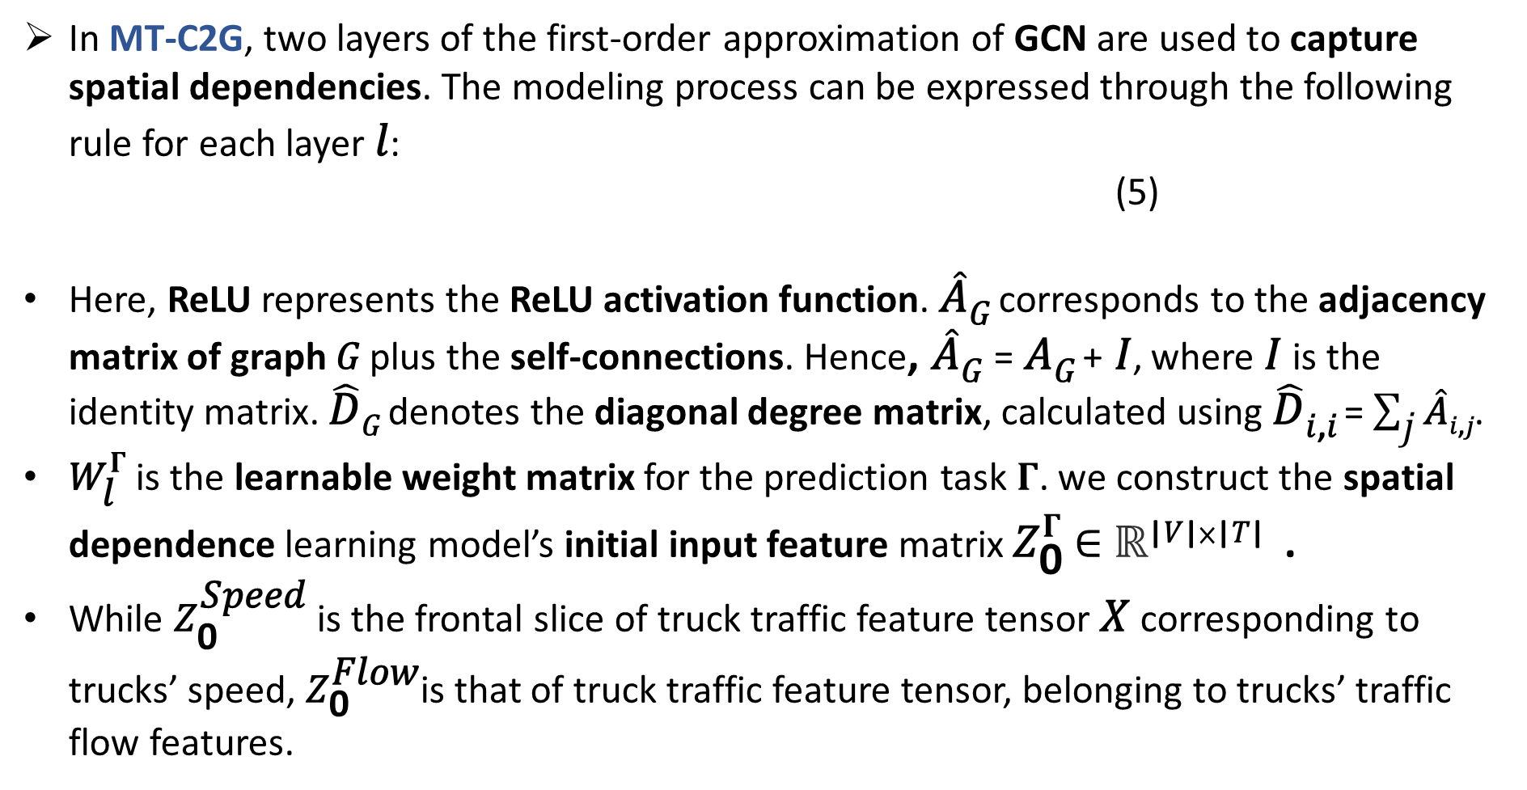
15
Spatial Dependence Model:
In MT-C2G, two layers of the first-order approximation of GCN are used to capture spatial dependencies. The modeling process can be expressed through the following rule for each layer 𝑙:
(5)
Here, ReLU represents the ReLU activation function. $\hat{\text{A}}$_{𝐺} corresponds to the adjacency matrix of graph 𝐺 plus the self-connections. Hence, $\hat{\text{A}}$_{𝐺} = 𝐴_{𝐺} + 𝐼, where 𝐼 is the identity matrix. $\hat{\text{D}}$_{𝐺} denotes the diagonal degree matrix, calculated using $\hat{\text{D}}$_{𝑖,𝑖} = $\sum_{\text{j}}{\hat{\text{A}}\text{i}\text{,}\text{j}}$.
${\text{W}}_{\text{l}}^{Γ}$ is the learnable weight matrix for the prediction task $Γ$. we construct the spatial dependence learning model’s initial input feature matrix ${\text{Z}}_{\text{0}}^{Γ}$ ∈ ℝ^{|𝑉|×|𝑇|} .
While ${\text{Z}}_{\text{0}}^{\text{Speed}}$ is the frontal slice of truck traffic feature tensor 𝑋 corresponding to trucks’ speed, ${\text{Z}}_{\text{0}}^{\text{Flow}}$is that of truck traffic feature tensor, belonging to trucks’ traffic flow features.

Slide 16
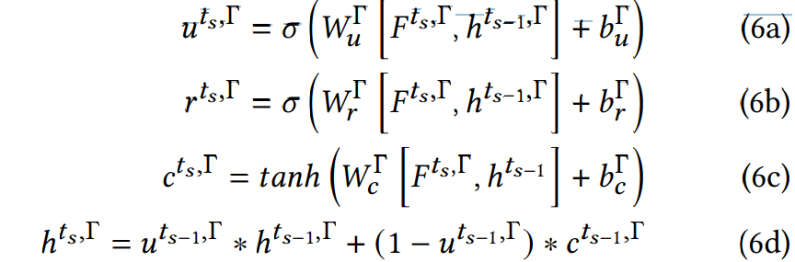
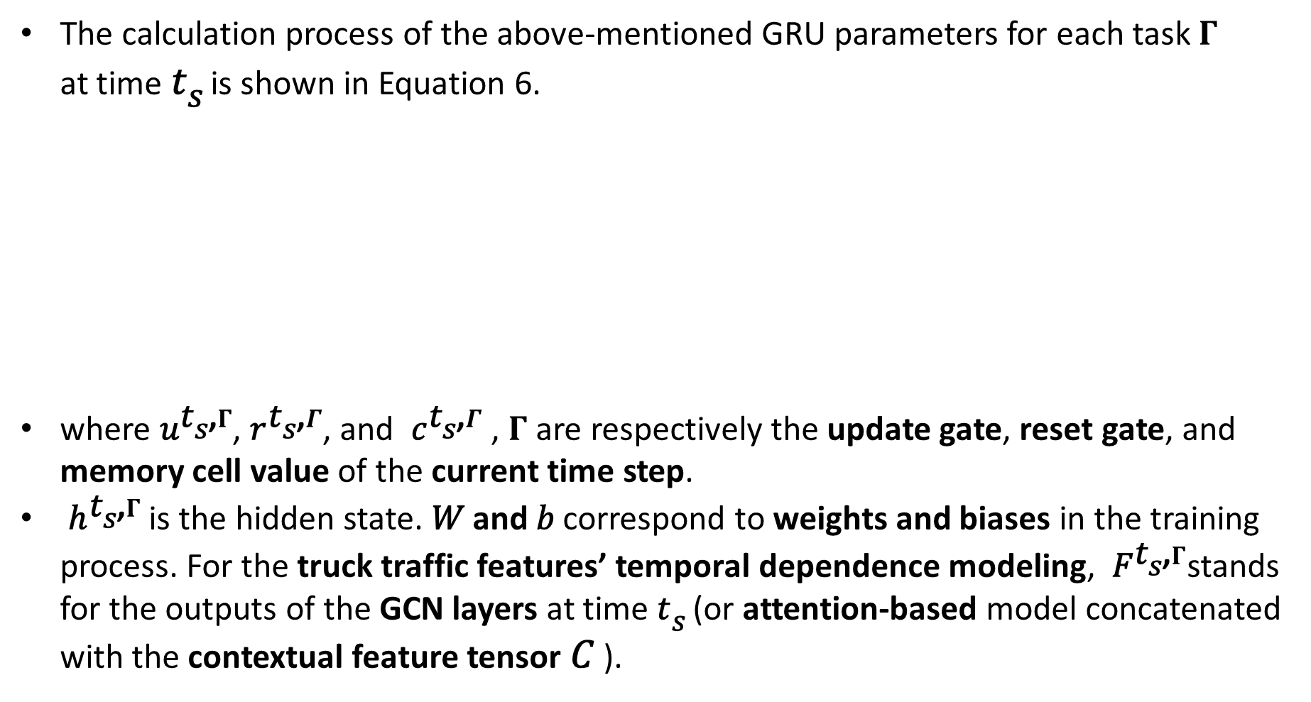
16
Temporal Dependence Model:
The calculation process of the above-mentioned GRU parameters for each task $Γ$ at time 𝑡_{𝑠} is shown in Equation 6.
where${ \text{u}}^{\text{t}\text{s}\text{,}Γ}$, ${\text{r}}^{\text{t}\text{s}\text{,}Γ}$, and ${ \text{c}}^{\text{t}\text{s}\text{,}Γ}$ , $Γ$ are respectively the update gate, reset gate, and memory cell value of the current time step.
${\text{h}}^{\text{t}\text{s}\text{,}Γ}$is the hidden state. 𝑊 and 𝑏 correspond to weights and biases in the training process. For the truck traffic features’ temporal dependence modeling, ${ \text{F}}^{\text{t}\text{s}\text{,}Γ}$stands for the outputs of the GCN layers at time 𝑡_{𝑠} (or attention-based model concatenated with the contextual feature tensor 𝐶 ).

Slide 17
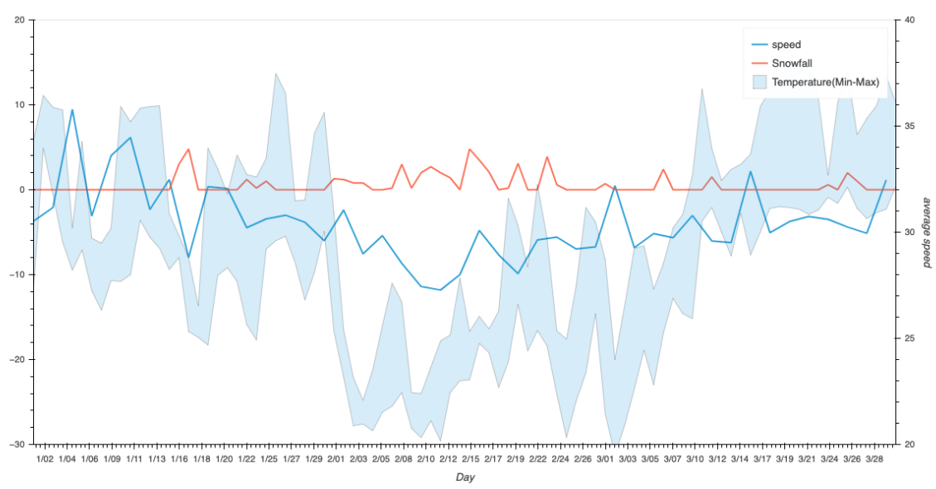
17
Contextual Feature Model:
Figure 2: Illustration of the influence of weather conditions on truck speed pattern. Red shows the amount of snow, blue line shows the average speed of trucks across the city, and blue area represents the minimum and maximum weather temperature.

Slide 18
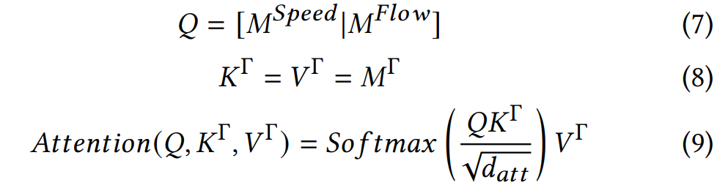
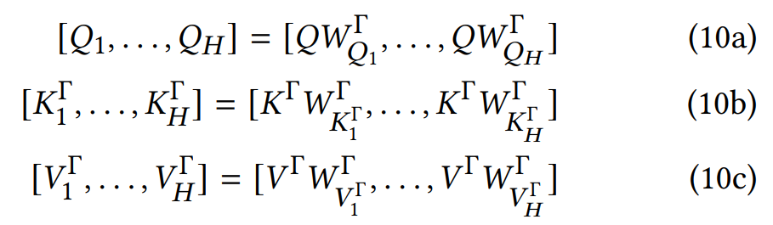

18
Multi-Task Learning Model:
The attention mechanism can be described as follows for each task $Γ$:
where 𝑑 corresponds to the embedding dimension. To take advantage of parallelism, the Query, Key, and Value are mapped to 𝐻 different sub-spaces. 𝑀$Γ$ represents the output of the first layer of GRU units.
where ${\text{W}}_{\text{Q}\text{i}}^{Γ}$, ${\text{W}}_{\text{K}\text{i}}^{Γ}$, and ${\text{W}}_{\text{V}\text{i}}^{Γ}$ are the conversion matrices.
Notes:
https://medium.com/@x02018991/%E6%A9%9F%E5%99%A8%E5%AD%B8%E7%BF%92%E7%AD%86%E8%A8%98-self-attention-fa6897080a0a

Slide 19
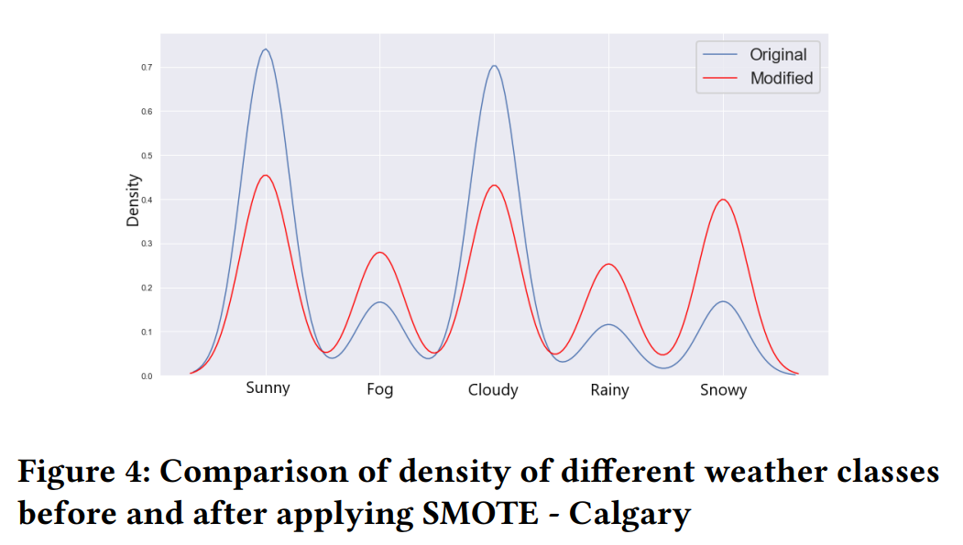
19
Experiment:

Slide 20
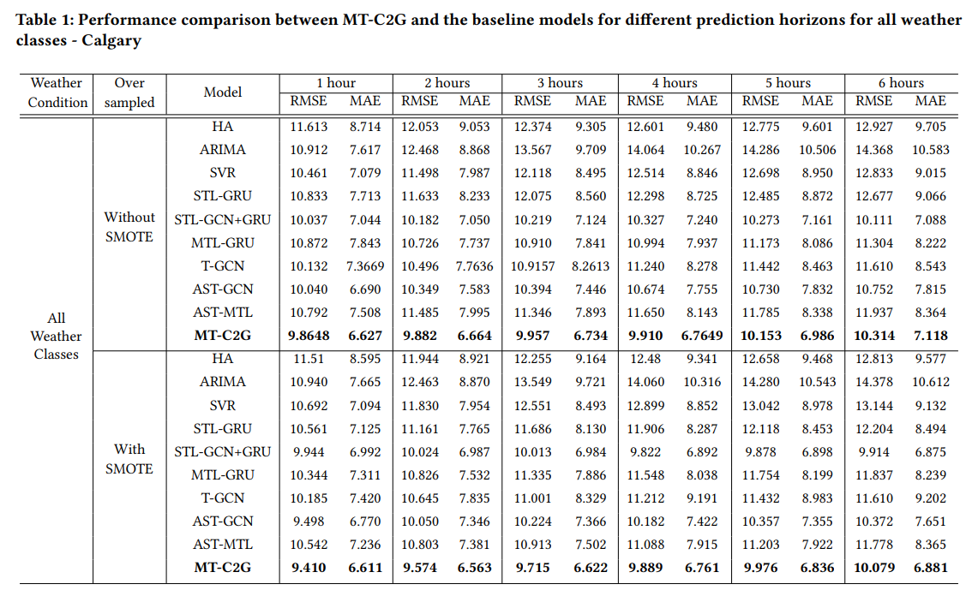
20
Experiment:

Slide 21
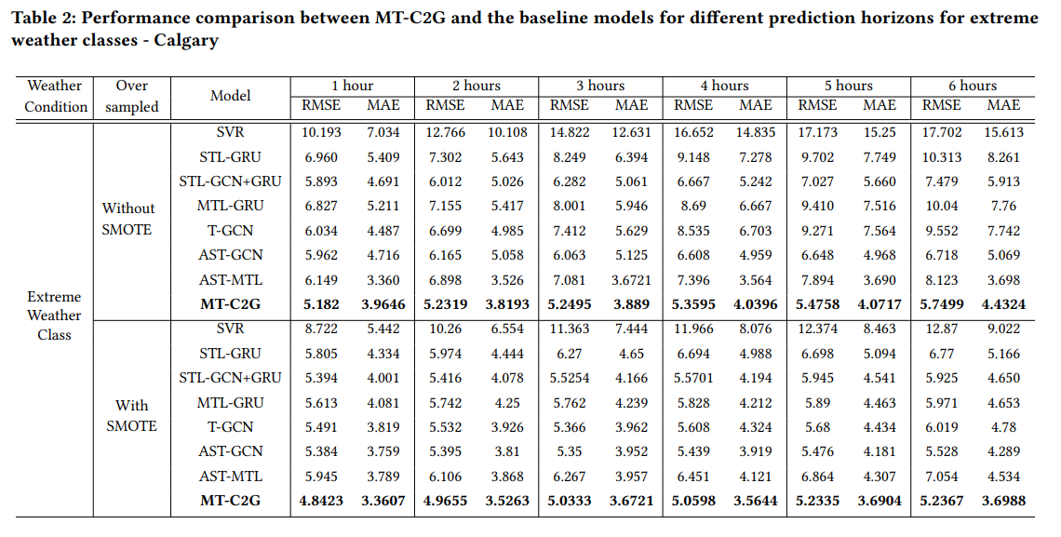
21
Experiment:

Slide 22
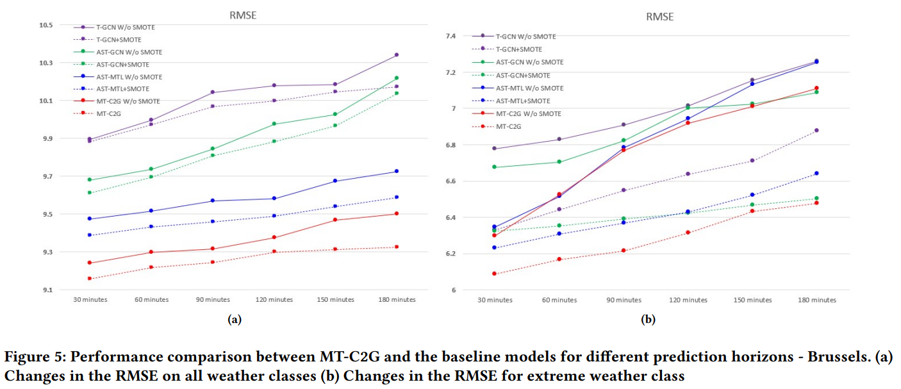
22
Experiment:

Slide 23
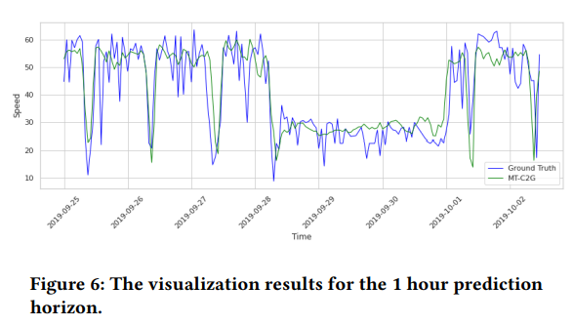
23
Experiment:
The figure contains a comparison of truck speed predictions from MT-G2C and MT-G2C without SMOTE, for the 1 hour time horizon.
One possible explanation for the sudden changes at peaks could be attributed to factors other than the contextual factors considered in this study, such as traffic accidents and road construction.

Slide 24
24
contributions:
MT-C2G takes the contextual features into account when predicting truck speed. It employs a layer of GRU units to capture the temporal dependence in multivariate time series of external factors, including temporal patterns shown in the historical truck traffic and contextual factors.
MT-C2G utilizes MTL model to obtain a reasonable speed prediction based on real-world truck speed and flow historical data.
- Considering truck speed and flow simultaneously, MT-C2G makes full use of the interactions between these two variables, as well as reducing the impact of noise and sparseness in the data, focusing on the relevant feature that provides more evidence, reducing the likelihood of overfitting.

Slide 25
25
contributions:
Truck speed and flow samples that are synchronized with extreme weather conditions are under-represented, but the samples should be emphasized during the training.
- To addresses the issue, MT-C2G utilizes the Synthetic Minority Oversampling Technique (SMOTE) to over-sample the data under the extreme weather conditions, which improves the truck speed prediction accuracy for extreme weather conditions.
We conduct extensive experiments on two real-world datasets, i.e. Calgary and Brussels truck traffic data, for evaluating the performance of MT-C2G model. Results prove that the proposed approach obtains significant improvement over state-of-the-art baseline methods.

Slide 26

THE END

